Slide 1
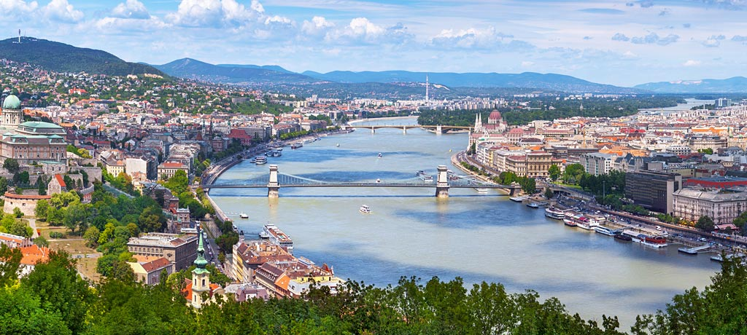
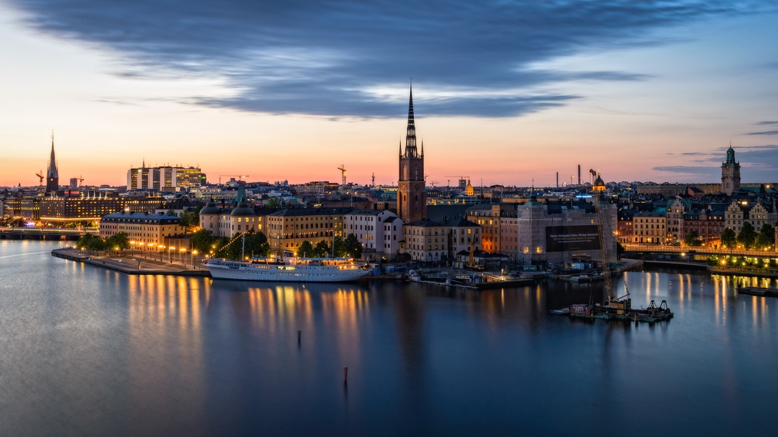
CAPITAL CITIES

Slide 2
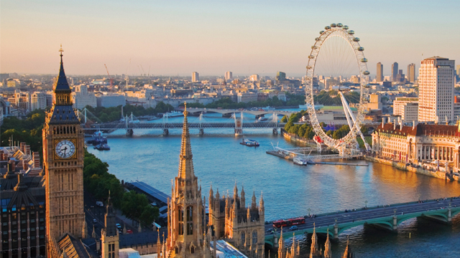
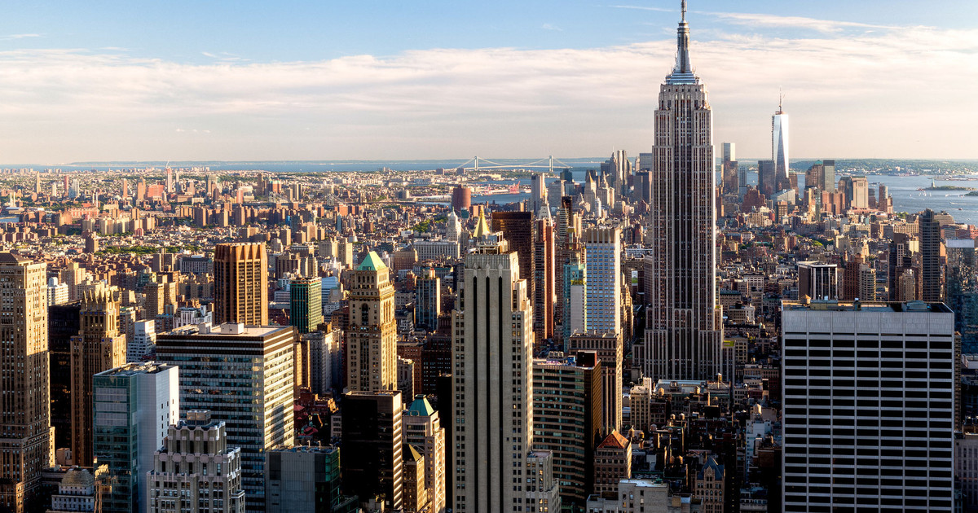

Slide 3
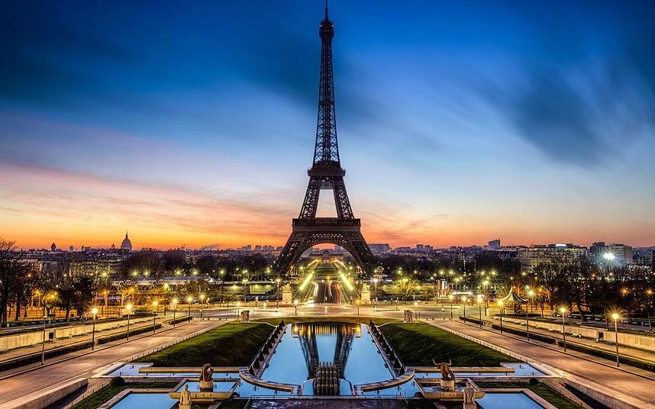
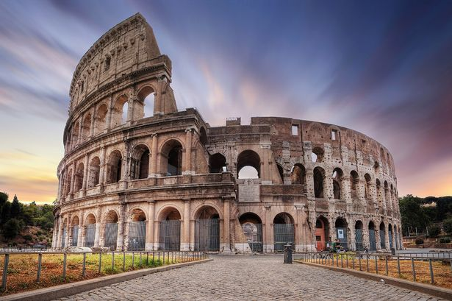

Slide 4

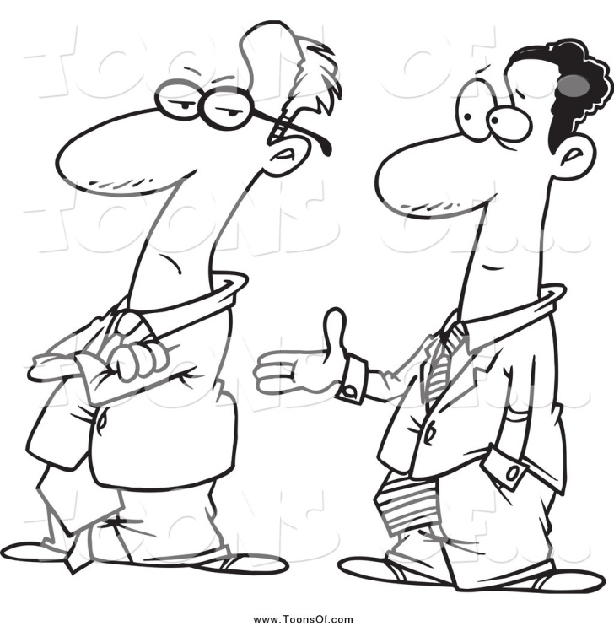
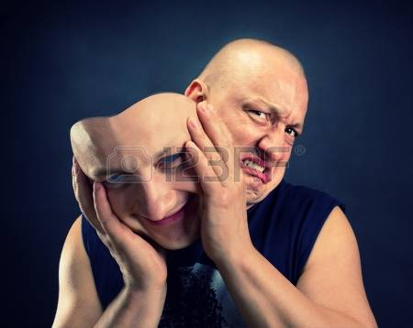
rude
polite
pretend

Slide 5
rude
polite
pretend

Slide 6
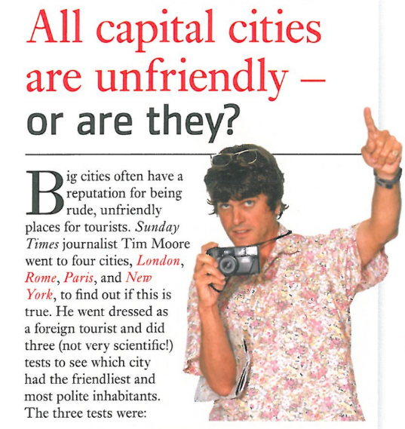
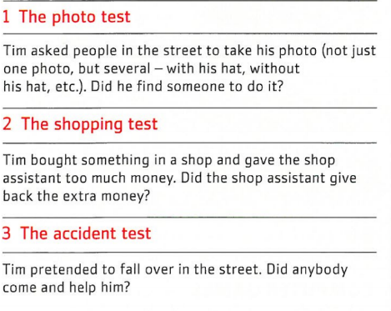

Slide 7
Have any of you been to all of these capital cities?

Slide 8

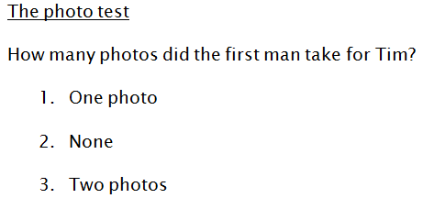
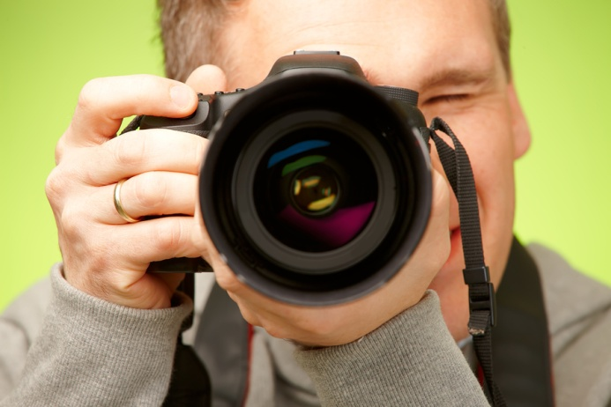

Slide 9
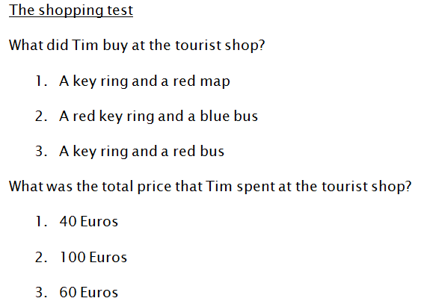
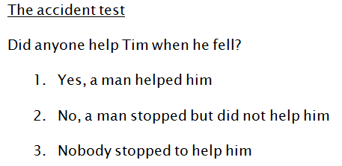

Slide 10
Answers:
The photo test- 2
The shopping test- 3, 1
The accident test- 2

Slide 11
Now, predict what happened to Tim in New York, Paris and Rome.
What cultural differences would you expect to find?
Think of your own country and how locals would respond to the 3 tests.
©Jeryn Lau

