Slide 1
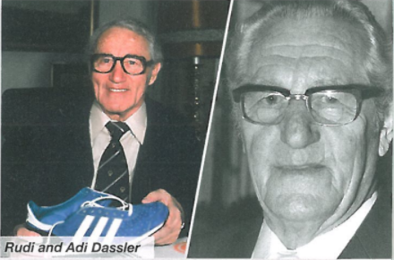
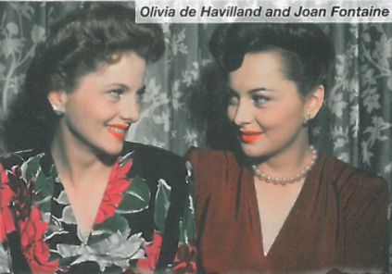
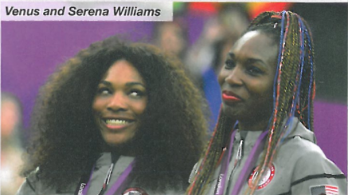
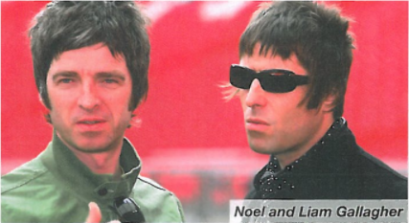
Siblings

Slide 2
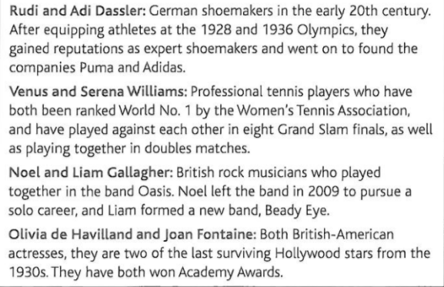
Siblings

Slide 3
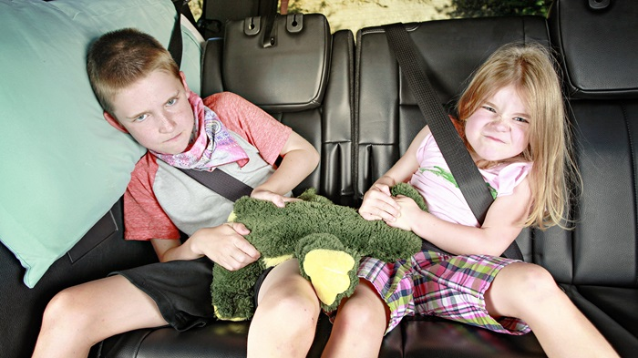
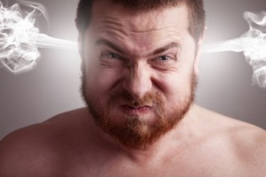
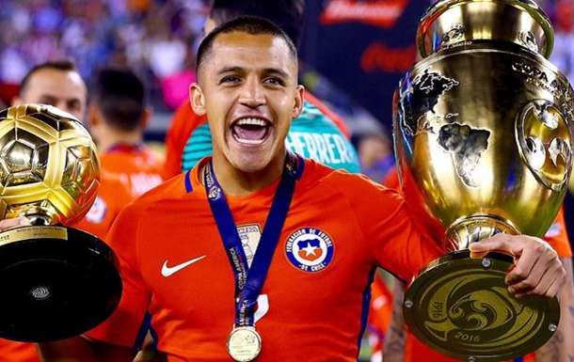
What do they mean?
boasted
livid
rivalry

Slide 4
What do they mean?
boasted
livid
rivalry

Slide 5
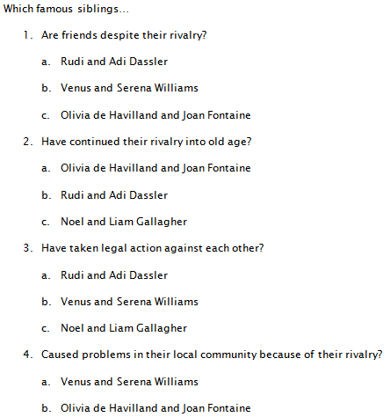
Questionnaire

Slide 6
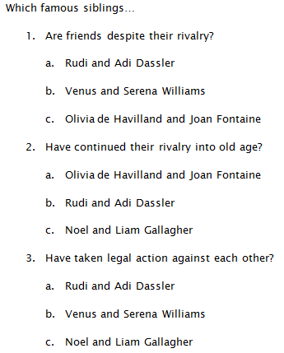

Slide 7
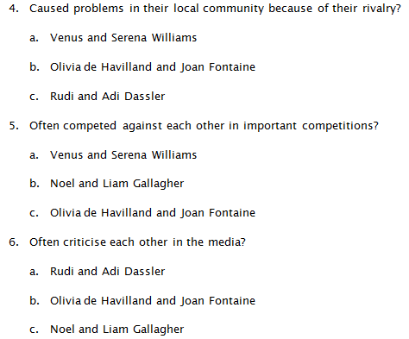

Slide 8
The author of the article felt competitive towards her sister because… | Achieved success before her sister did.
2. In her autobiography, Joan Fontaine boasted that she had… | b. They had very different working styles.
3. A lot of people were watching when Olivia de Havilland… | c. He was trying to work but his brother had friends over.
4. Noel Gallagher once attacked his brother because… | d. They play against each other in competitions.
5. Some people in Herzogenaurach refused to socialise with each other because… | e. She had always felt that her sister was prettier.
6. The Dassler brothers started separate companies because… | f. She still dislikes looking at their photos together.
7. The William sisters are best friends despite the fact that… | g. Won an Oscar but refused to shake her sister’s hand.
8. We know the author of the article is still competitive towards her sister because… | h. They supported different brands.

Slide 9
Answers
(1) | (e)
(2) | (a)
(3) | (g)
(4) | (c)
(5) | (h)
(6) | (b)
(7) | (d)
(8) | (f)

